Slide 1
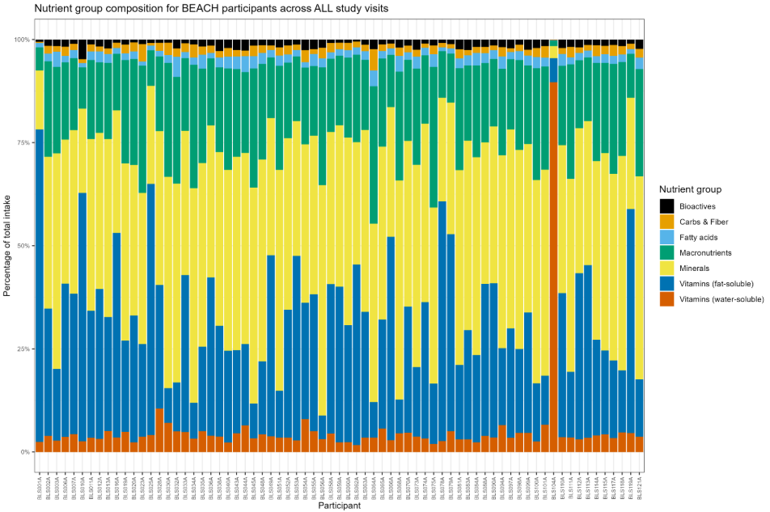
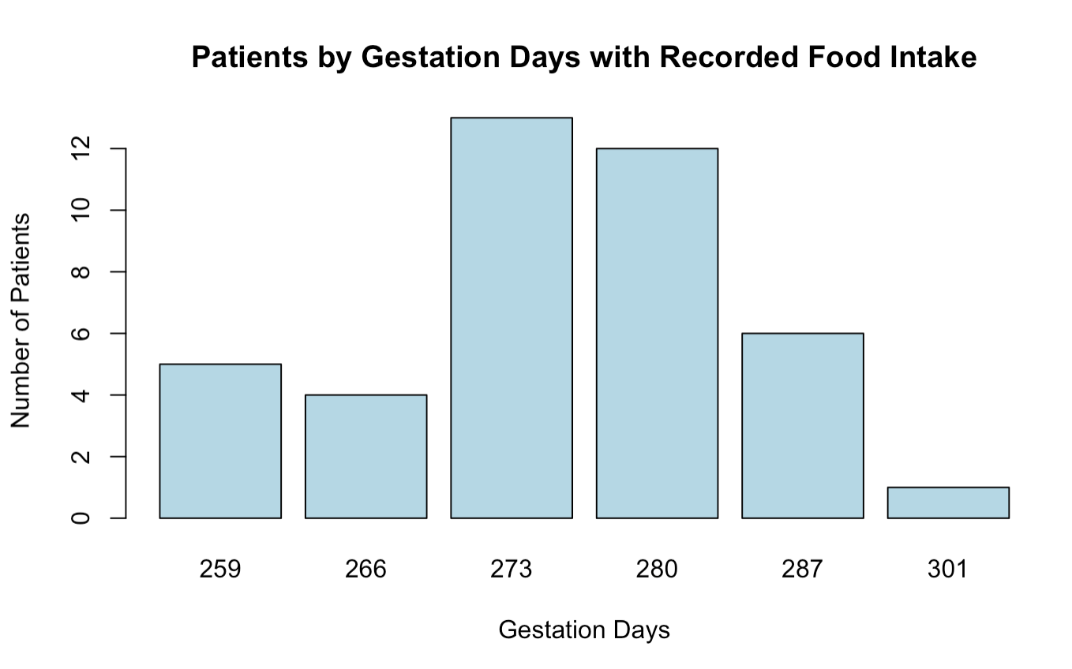
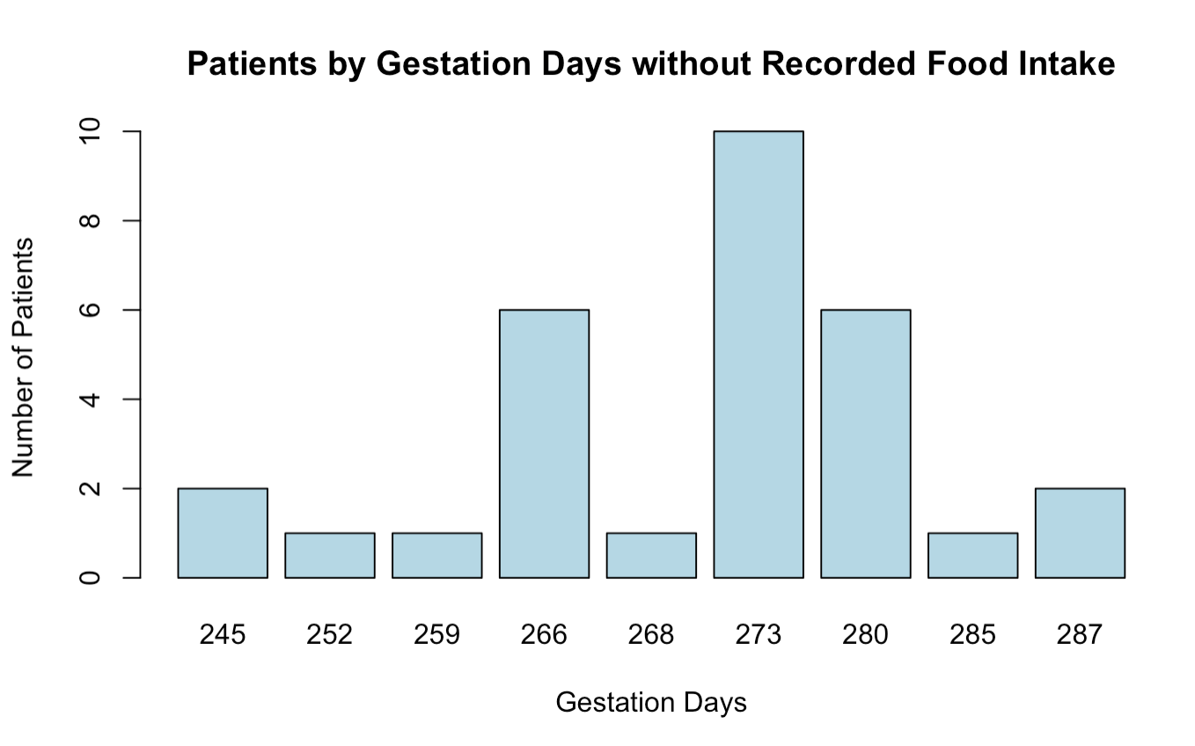
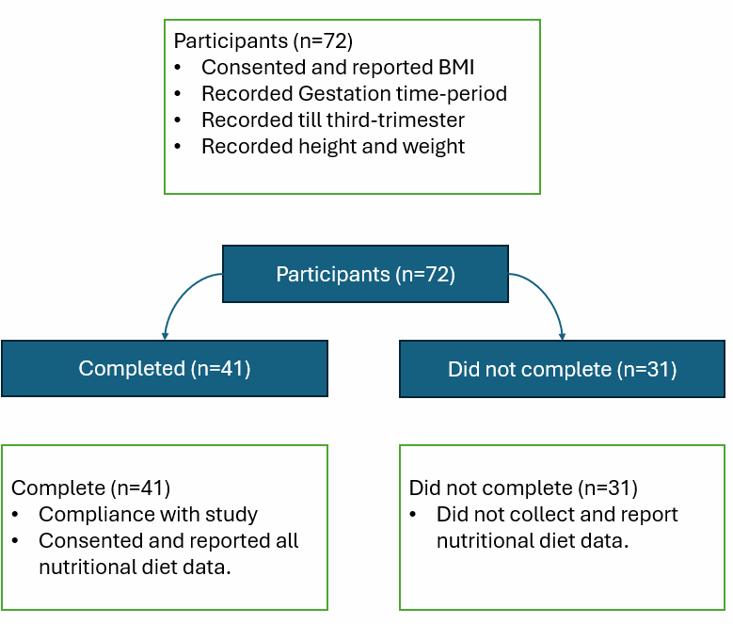
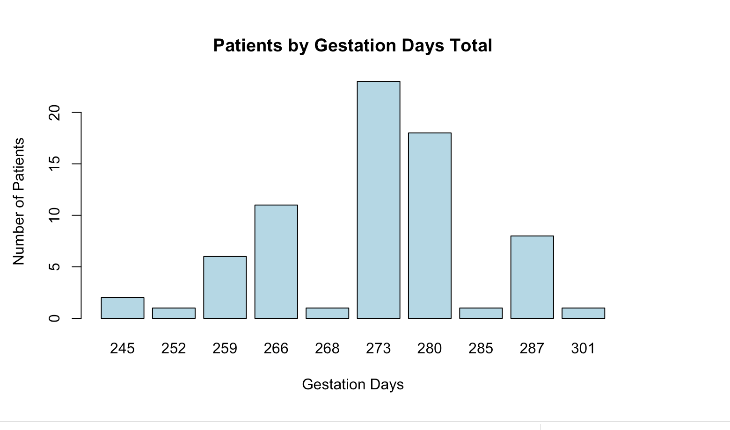

Dietary Analysis of the Breastfeeding and Early Child
(BEACH) Study
Authors & Affiliations: Alexandra Bochna, Sarah Duncan, Natasha Davis, Vedant Patel, Dominick J. Lemas, PhD
Introduction
Results
Discussion
Maternal pre-pregnancy BMI shapes maternal health, pregnancy outcomes, and the nutritional environment infants experience.
Maternal diet quality impacts fetal growth, metabolic programming, and early-life nutritional exposures that shape long-term health.
Based on the Welch’s t-test (p = 0.08402), we fail to reject the null hypothesis and conclude that the average gestation period is very similar between the two groups.
The study was limited by a small sample size and incomplete dietary data, which reduced statistical power, and the use of self-reported macronutrient intake introduced potential bias from underreporting and inconsistent logging.
Future research should increase sample size and use more accurate dietary tracking tools to improve the reliability of nutrient data.
A major priority is to examine in greater depth how specific macronutrient patterns influence maternal BMI, including how protein, carbohydrate, and fat intake relate to BMI changes across pregnancy.
Figure 1: Percentage of nutrient intake for BEACH participants across all study visits
Objectives
Evaluate dietary patterns in longitudinal birth study called the BEACH study.
Methods
Figure 2: Average gestation period for participants who recorded their daily food intake, and tracked their macros through the whole study
Figure 3: Average gestation period for participants who did not record their daily food intake and track their macros the whole study.
Conclusion
Conclusion
The was no significant connection or difference found between the gestation days of those who complied and didn’t comply with the study. This means that data that was not collected probably didn't include significant outliers and conclusion can be drawn from available data.
Figure 4: Average Gestation period for all participants in the BEACH study
Figure 1. Consort Diagram
T-test p-value: 0.08
Acknowledgements, Funding, We thank out participants for the continuous support,.

